Slide 1
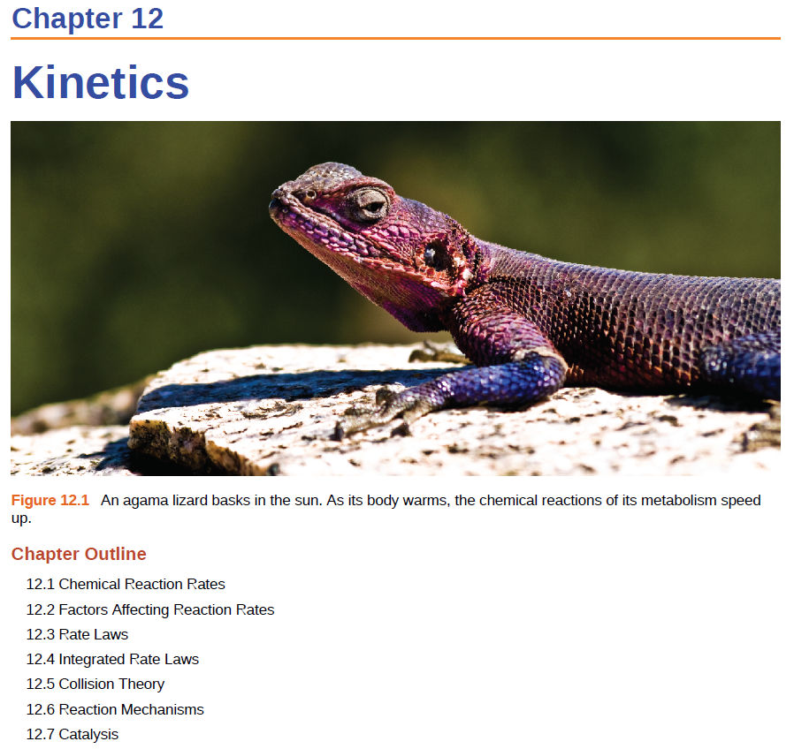
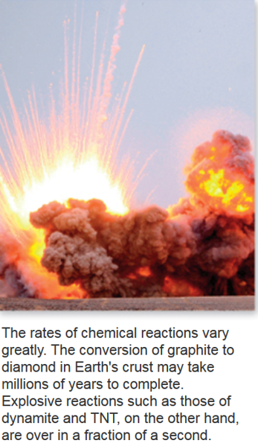

Slide 2
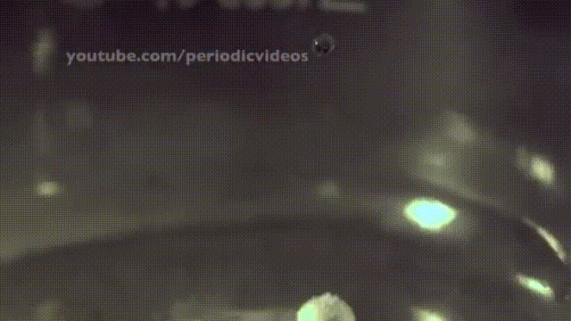
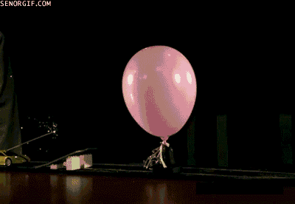
Chemical Reactions
A B
Alkali metals react violently with water
2Na + 2H₂O ⎯→ 2NaOH + H₂
H₂ and O₂ do not react under normal conditions, but can react explosively from one spark
2H₂ + O₂ ⎯→ 2H₂O

Slide 3
Reaction Rate
Thermodynamics (CH 5 + 16) – does a reaction take place?
Kinetics – how fast does a reaction proceed?
The reaction rate is defined as the change in concentration per unit of time:
C_{f} and C_{i} – concentration of the starting reactant at times t_{f} and t_{i}, respectively (t_{f} > t_{i})

Slide 4
Chemical Kinetics
Reaction rate is the change in the concentration of a reactant or a product with time (M/s).
A B
Δ[A]
Δ[A] = change in concentration of A over
time period Δt
rate = -
Δt
Δ[B]
Δ[B] = change in concentration of B over
time period Δt
rate =
Δt
Because [A] decreases with time, Δ[A] is negative.

Slide 5
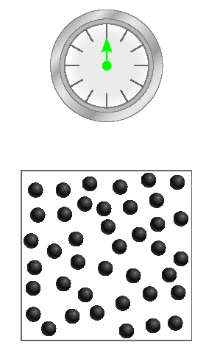
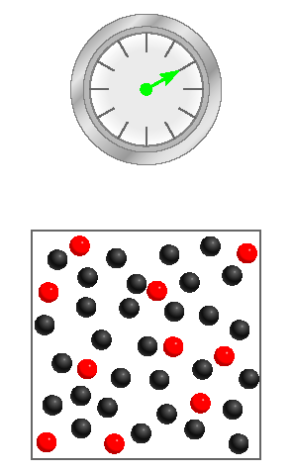
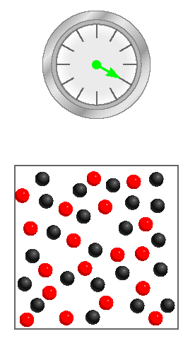
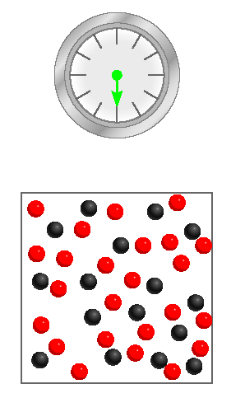
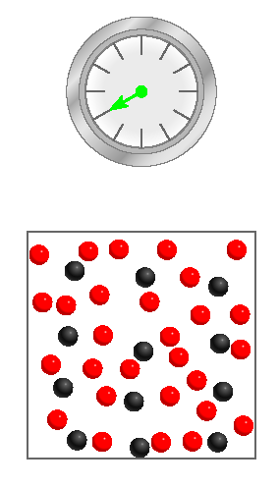
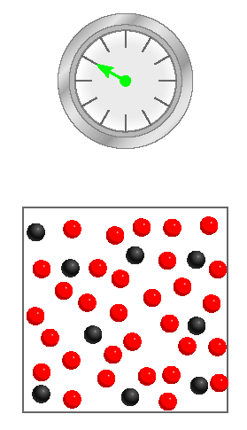
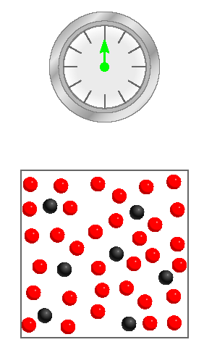
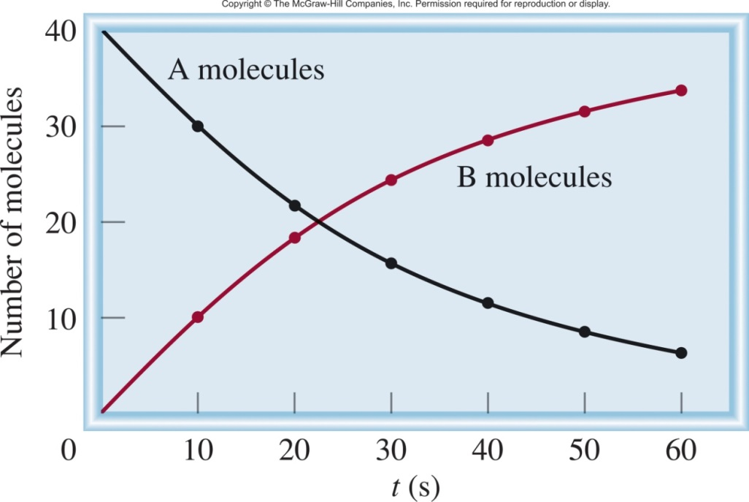
A B
10 red
18 red
24 red
28 red
31 red
33 red
Δ[A]
rate = -
Δt
Δ[B]
rate =
Δt

Slide 6
Relative Reaction Rates
A B
One mole of A disappears for each mole of B that is formed.
Δ[A]
Δ[B]
rate = -
rate =
Δt
Δt
2C D
Two moles of C disappear for each mole of D that is formed.
Δ[C]
Δ[D]
2 x rate = -
rate =
Δt
Δt
or
1
Δ[C]
rate = -
2
Δt

Slide 7
General Reaction Rate Expression
For a general reaction:
the reaction rate can be expressed as
aA + bB ⎯→ cC + dD

Slide 8
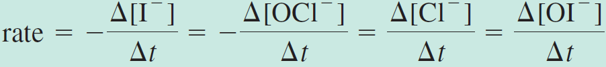
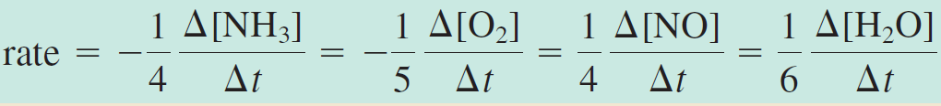
Write the rate expressions for the following reactions in terms of the disappearance of the reactants and the appearance of the products:

Slide 9
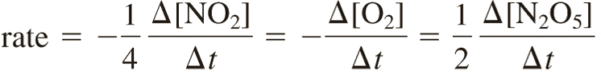
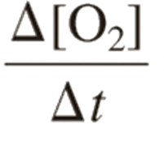
Consider the reaction
Suppose that, at a particular moment during the reaction, molecular oxygen is reacting at the rate of 0.024 M/s.
At what rate is N₂O₅ being formed?
At what rate is NO₂ reacting?
1) Write the reaction rate for each species:
2) Know the oxygen reaction rate:
=
-0.024 M/s
3) Do algebra:

Slide 10


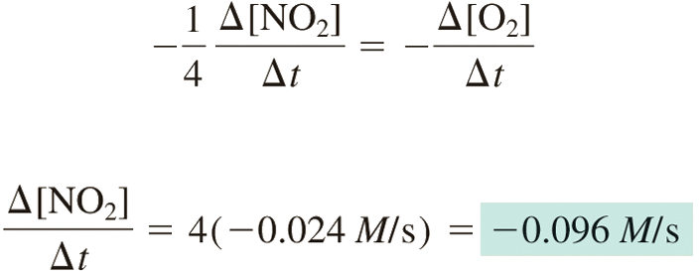
=
-0.024 M/s
For [N₂O₅]:
For [NO₂]:

Slide 11


Slide 12
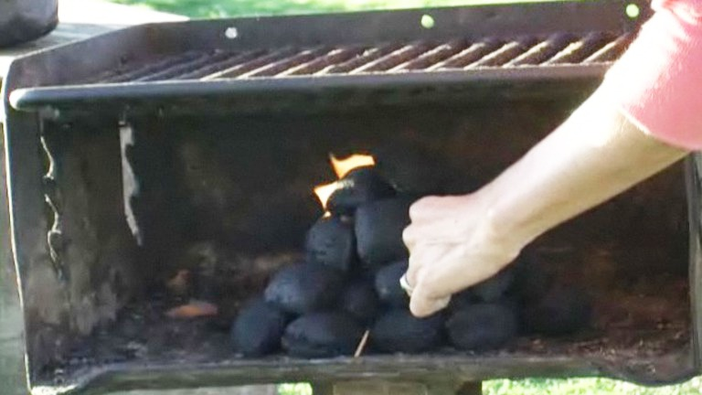
Factors Affecting Reaction Rates
Nature of the reacting species (Fe vs Na)
State of the Reactants
Reactions happen at the interface (powder faster than rod)
Temperature
Catalyst
Concentrations of the reactants
2Fe(s) + 6HCl(aq) ⟶ 2FeCl3(aq) + 3H2(g)
https://www.youtube.com/watch?v=UjPxDOEdsX8
Starting a grill.
Starting a grill w/ liquid O₂.

Slide 14
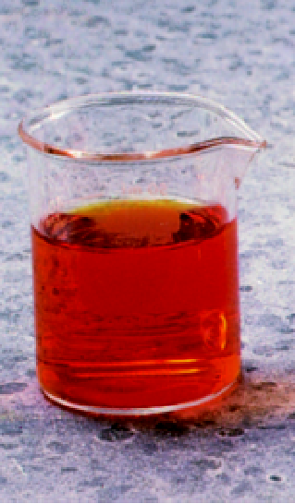
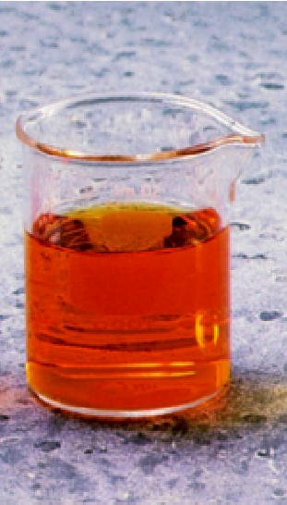
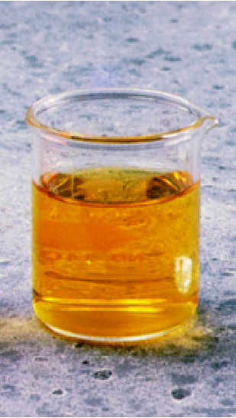
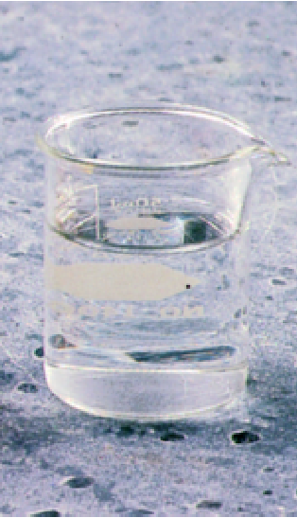
Experimental Determination of Rates
red-brown
Colorless
Br₂ (aq) + HCOOH (aq) 2Br⁻ (aq) + 2H⁺ (aq) + CO₂ (g)
Time
Δ[color]
rate = -
Δt

Slide 15


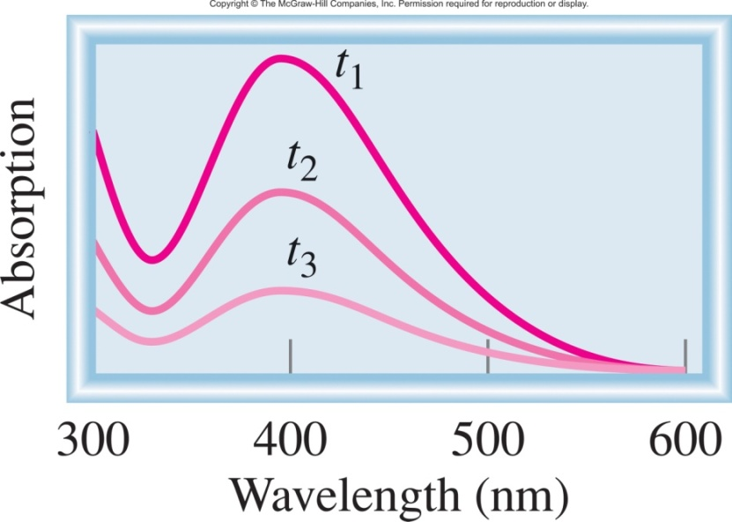

Experimental Determination of Rates
Br₂ (aq) + HCOOH (aq) 2Br⁻ (aq) + 2H⁺ (aq) + CO₂ (g)
time
393 nm
Detector
light
Δ[Br₂] α Δ Absorption

Slide 16

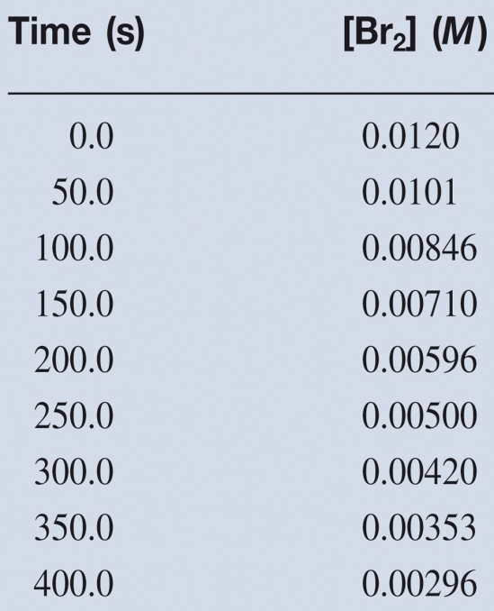
Experimental Determination of Rates
Br₂ (aq) + HCOOH (aq) 2Br⁻ (aq) + 2H⁺ (aq) + CO₂ (g)
Δ[Br₂] α Δ Absorption
Calculate Rate:
Δ[Br₂]
[Br₂]_{final} – [Br₂]_{initial}
rate = -
= -
Δt
t_{final} - t_{initial}

Slide 17
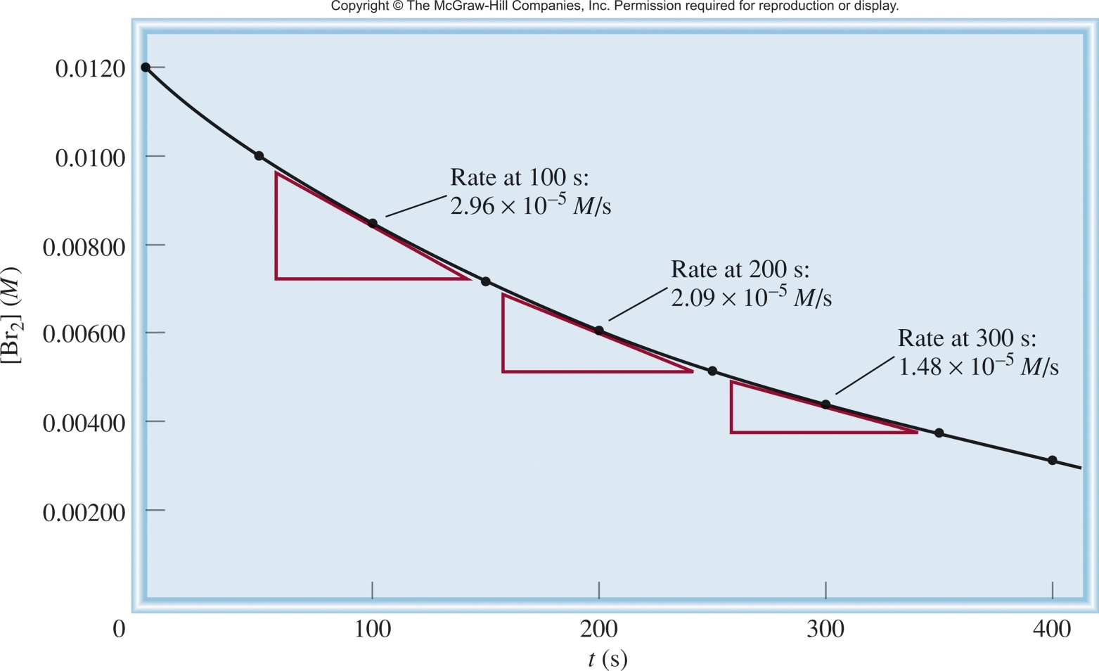
Experimental Determination of Rates
Rate changes with [conc]
rate α [Br₂]
We need a better way to describe the rate!
slope of
tangent
slope of
tangent
slope of
tangent
Δ[Br₂]
[Br₂]_{final} – [Br₂]_{initial}
rate = -
= -
Δt
t_{final} - t_{initial}
instantaneous rate = rate for specific instance in time

Slide 18
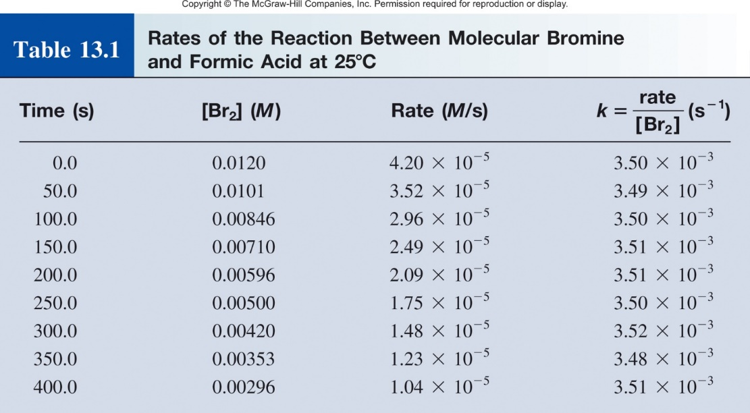
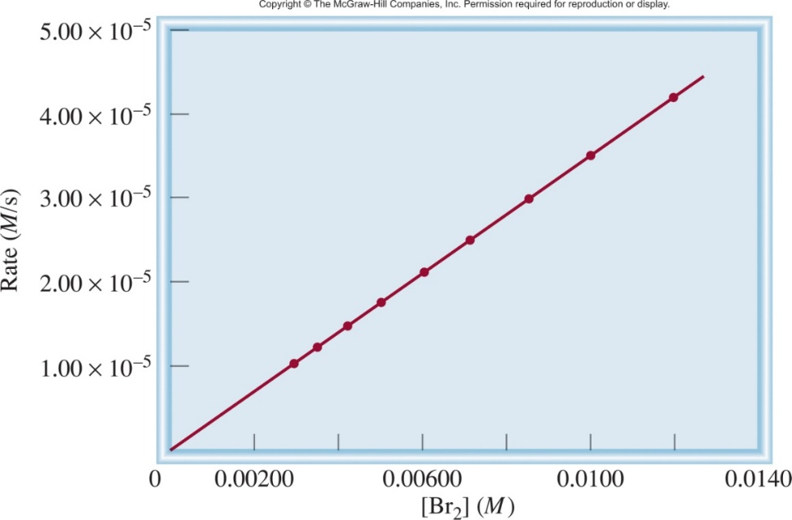
Experimental Determination of Rates
rate α [Br₂]
rate = k [Br₂] + 0
rate
k =
= rate constant
[Br₂]
= 3.50 x 10⁻³ s⁻¹
rate constant- constant of the proportionality between the reaction rate and the concentration of reactant.
General descriptor for the rate of a reaction that is independent of [conc].

Slide 19
Rate Law
Br₂ (aq) + HCOOH (aq) 2Br⁻ (aq) + 2H⁺ (aq) + CO₂ (g)
rate α [Br₂]
Can describe the rate of a complex reaction with one simple equation that is dependent on a few reactants, using the Rate Law!
rate = k [Br₂]
The rate law expresses the relationship of the rate of a reaction to the rate constant and the concentrations of the reactants raised to some powers.
aA + bB ⎯→ cC + dD
The rate law for a general reaction takes the form:

Slide 20
Rate Law
aA + bB ⎯→ cC + dD
The rate law for a general reaction takes the form:
Reaction order is “always” defined in terms of reactant (not product) concentrations.
x and y are the order of the reaction.
The power coefficients x and y are not the same as the stoichiometric coefficients a and b.
Rate laws (x and y, and reactants involved) are “always” determined experimentally.

Slide 21
Reaction Order
aA + bB ⎯→ cC + dD
The rate law for a general reaction takes the form:
Reaction order- specify the relationship between the concentrations of reactants A and B and the reaction rate.
Reaction is xth order in A
Reaction is yth order in B
Reaction is (x +y)th order overall
If a reagent is zero order it is not included in the rate law.
Helps to explain the mechanism of the reaction. Order tells you what molecules are involved in the rate limiting step and how of each molecule are needed.

Slide 22
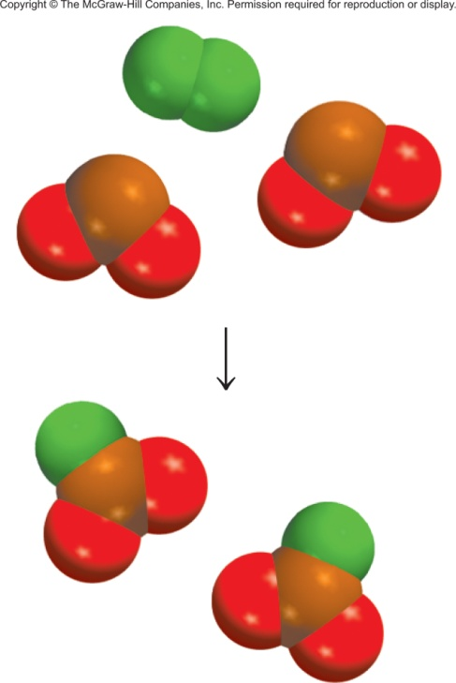
Reaction Order
aA + bB ⎯→ cC + dD
Important Note: the power coefficients x and y are not the same as the stoichiometric coefficients a and b.
F₂ (g) + 2ClO₂ (g) 2FClO₂ (g)
1
rate = k [F₂][ClO₂]
The reaction is rate determined by the collision and reaction of 1 F₂ and 1 ClO₂.
But…when each reaction is complete 2 ClO₂ and 1 F₂ are consumed.

Slide 23
Reaction Order and Rate
How will the rate of the following reaction change when the concentration changes by:
2NO_{(g)} + O_{2(g)} ⎯→ 2NO_{2(g)}
a) NO doubled
k is constant, conc and rate changing
The rate:
stays the same
doubles
quadruples
halves (1/2 the rate)
rate = [1]²[1]
= 1
= 4
rate = [2]²[1]

Slide 24
Reaction Order and Rate
How will the rate of the following reaction change when the concentration changes by:
2NO_{(g)} + O_{2(g)} ⎯→ 2NO_{2(g)}
b) NO halved
The rate:
¼ the rate
stays the same
halves
quadruples
rate = [1]²[1]
= 1
rate = [0.5]²[1]
= 0.25

Slide 25
Reaction Order and Rate
How will the rate of the following reaction change when the concentration changes by:
2NO_{(g)} + O_{2(g)} ⎯→ 2NO_{2(g)}
c) O₂ doubled
The rate:
stays the same
quadruples
¼ the rate
doubles
rate = [1]²[1]
= 1
rate = [1]²[2]
= 2

Slide 26
Reaction Order and Rate
How will the rate of the following reaction change when the concentration changes by:
2NO_{(g)} + O_{2(g)} ⎯→ 2NO_{2(g)}
d) O₂ halved
The rate:
¼ the rate
halves
stays the same
quadruples
rate = [1]²[1]
= 1
rate = [1]²[0.5]
= 0.5

Slide 27
Practice Problem
A chemical reaction between A and B is first order with respect to A, first order with respect to B, and second order overall. From the information given below, fill in the blanks.
Experiment | Initial Rate (M/s) | Initial [A] (M) | Initial [B] (M)
1 | 4.0 x 10⁻³ | 0.20 | 0.050
2 | 1.6 x 10⁻² |  | 0.050
3 | 3.2 x 10⁻² | 0.40
rate = k [A]¹[B]¹

Slide 28
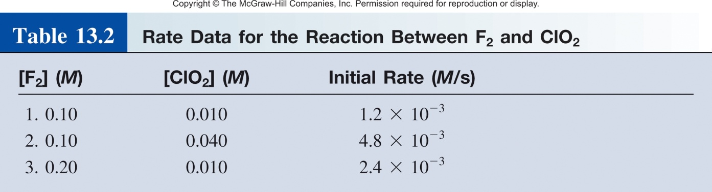
Determining Rate Laws (by inspection)
F₂ (g) + 2ClO₂ (g) 2FClO₂ (g)
Vary concentrations.
Measure rate.
Tabulate the data.
rate = k [F₂]^{x}[ClO₂]^{y}
Comparing rxn 1 and 2:
[F₂] constant, [ClO₂] quadruples, rate quadruples
rate α [ClO₂]
y = 1

Slide 29
Determining Rate Laws (by inspection)
F₂ (g) + 2ClO₂ (g) 2FClO₂ (g)
Vary concentrations.
Measure rate.
Tabulate the data.
rate = k [F₂]^{x}[ClO₂]^{y}
Comparing rxn 1 and 2:
[F₂] constant, [ClO₂] quadruples, rate quadruples
rate α [ClO₂]
y = 1
Comparing rxn 1 and 3:
[ClO₂] constant, [F₂] doubles, rate doubles
rate α [F₂]
x = 1

Slide 30
Determining Rate Laws (by inspection)
F₂ (g) + 2ClO₂ (g) 2FClO₂ (g)
Vary concentrations.
Measure rate.
Tabulate the data.
rate = k [F₂]¹[ClO₂]¹
Calculate the rate constant (k)?
Can use any experiment!
rate₁ = 1.2x10⁻³ M/s = k [0.1 M]¹[0.1 M]¹
k = 0.012 M⁻¹ s⁻¹
Measure [conc] over time
find rate law
calculate rate constant

Slide 31
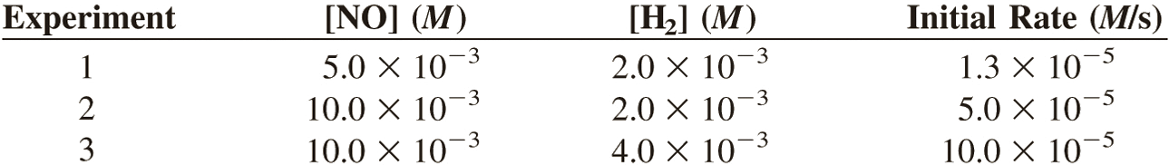
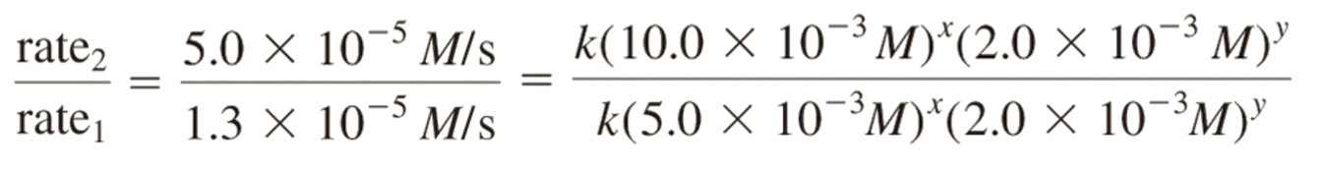
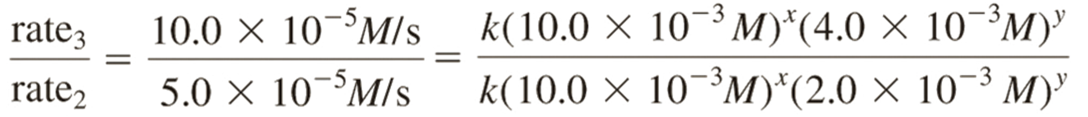
Determining Rate Laws (with Math)
rate = k[NO]^{x} [H₂]^{y}
Ratio of rxn 1 and 2:
x = 2
~4
=
2^{x}
Ratio of rxn 2 and 3:
y = 1
2
=
2^{y}

Slide 32
Practice Problem
The following rate data were obtained at 25°C for the reaction. What is the rate-law expression and the specific rate-constant for this reaction?
2A_{(g)} + B_{(g)} ⎯→ 3C_{(g)}
Experiment Number | Initial [A] (M) | Initial [B] (M) | Initial rate of formation of C (M/s)
1 | 0.10 | 0.10 | 2.0 x 10⁻⁴
2 | 0.20 | 0.10 | 4.0 x 10⁻⁴
3 | 0.10 | 0.20 | 2.0 x 10⁻⁴
rate = k [A]^{x}[B]^{y}
Comparing rxn 1 and 2:
[B] constant, [A] doubles, rate doubles
rate α [A]
x = 1

Slide 33
Practice Problem
The following rate data were obtained at 25°C for the reaction. What is the rate-law expression and the specific rate-constant for this reaction?
2A_{(g)} + B_{(g)} ⎯→ 3C_{(g)}
Experiment Number | Initial [A] (M) | Initial [B] (M) | Initial rate of formation of C (M/s)
1 | 0.10 | 0.10 | 2.0 x 10⁻⁴
2 | 0.20 | 0.10 | 4.0 x 10⁻⁴
3 | 0.10 | 0.20 | 2.0 x 10⁻⁴
rate = k [A]¹[B]^{y}

Slide 34
Practice Problem
The following rate data were obtained at 25°C for the reaction. What is the rate-law expression and the specific rate-constant for this reaction?
2A_{(g)} + B_{(g)} ⎯→ 3C_{(g)}
Experiment Number | Initial [A] (M) | Initial [B] (M) | Initial rate of formation of C (M/s)
1 | 0.10 | 0.10 | 2.0 x 10⁻⁴
2 | 0.20 | 0.10 | 4.0 x 10⁻⁴
3 | 0.10 | 0.20 | 2.0 x 10⁻⁴
rate = k [A]¹[B]^{y}
Comparing rxn 1 and 3:
[A] constant, [B] doubles, rate stays the same
rate α [B]⁰
x = 0

Slide 35
Practice Problem
The following rate data were obtained at 25°C for the reaction. What is the rate-law expression and the specific rate-constant for this reaction?
2A_{(g)} + B_{(g)} ⎯→ 3C_{(g)}
Experiment Number | Initial [A] (M) | Initial [B] (M) | Initial rate of formation of C (M/s)
1 | 0.10 | 0.10 | 2.0 x 10⁻⁴
2 | 0.20 | 0.10 | 4.0 x 10⁻⁴
3 | 0.10 | 0.20 | 2.0 x 10⁻⁴
rate = k [A]¹[B]⁰
rate = k [A]¹
reaction rate is independent of [B]

Slide 36
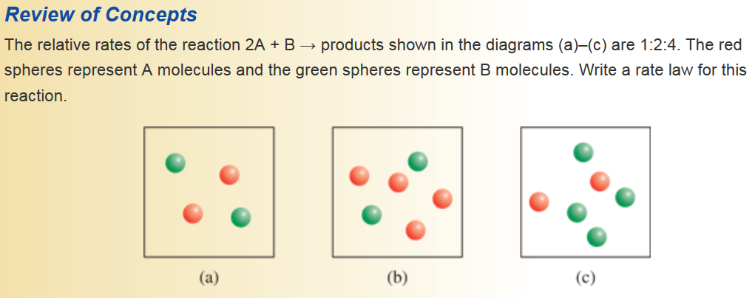
Practice Problem

Slide 37
Rate Expression vs Rate Laws
For a general reaction:
aA + bB ⎯→ cC + dD
Rate expression:
Rate equation:
rate = k [A]^{x}[B]^{y}
From the chemical equation.
Tells you how concentrations change relative to each other over time.
Describes both reactants a products.
Rate is conc dependent.
Determined Experimentally.
Gives you the rate constant.
Tells you how rate changes with concentration change.
Only describes reactants.

Slide 39
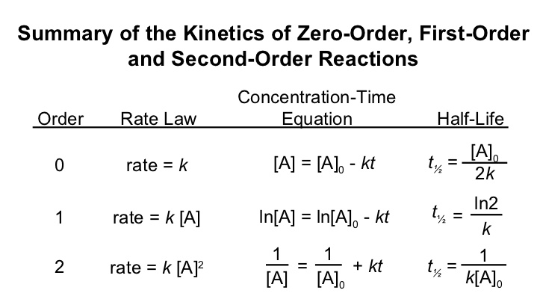
Reactant Concentration and Time
General rate law:
Relates rate and concentration via rate constant.
Tells you the order of the reaction.
Rate constant is good for comparing different reactions.
Can also be used, with minor modification, to predict concentrations at any time and vice versa!

Slide 40
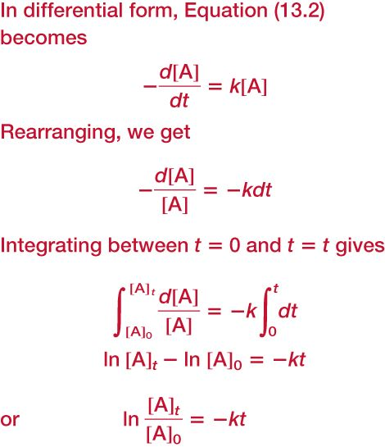


First Order Reactions
Rate law can also be used, with minor modification, to predict concentrations at any time and vice versa!
A B
Reaction rate:
Rate Law:
Δ[A]
rate = -
rate = k [A]
Δt
Δ[A]
-
= k [A]
Δt
Calculus Happens!
or

Slide 41
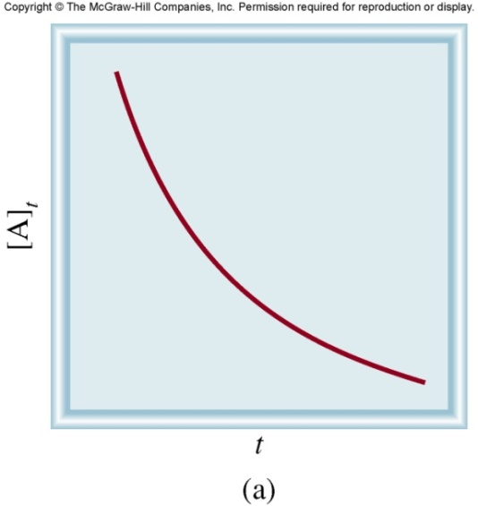
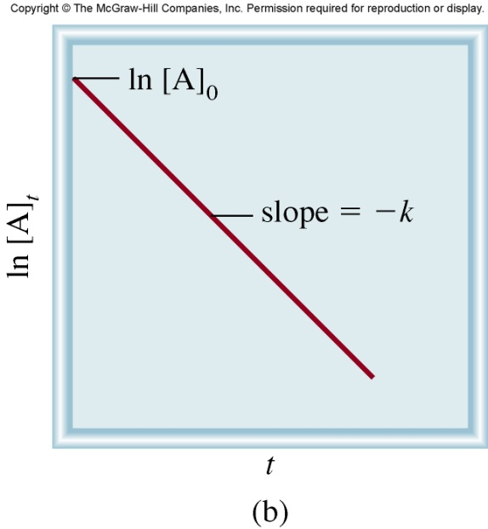
First Order Reactions
or
t is time
[A]_{t} is the concentration of A at any time t
[A]₀ is the concentration of A at time t=0
k is the rate constant
y = m • x + b
ln[A]_{t} = -k • t + ln[A]₀
Know [A]₀ and t, predict [A]_{t}
Know [A]₀ and [A]_{t}, predict t
Know [A]_{t} and t, predict [A]₀

Slide 42
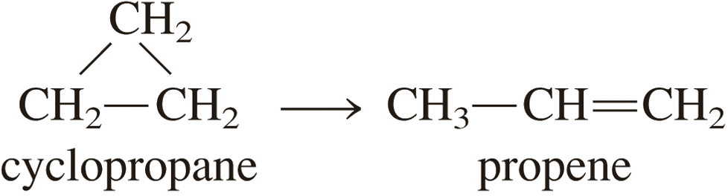
The conversion of cyclopropane to propene in the gas phase is a first-order reaction with a rate constant of 6.7 × 10⁻⁴ s⁻¹ at 500°C.
If the initial concentration of cyclopropane was 0.25 M, what is the concentration after 8.8 min?
How long (in minutes) will it take for the concentration of cyclopropane to decrease from 0.25 M to 0.15 M?
How long (in minutes) will it take to convert 74 percent of the starting material?
ln[A]_{t} = -k • t + ln[A]₀
Know k. Given [A]₀ and t. Find [A]_{t}.
Know k. Given [A]₀ and [A]_{t}. Find t.
Know k. Given [A]₀ and [A]_{t}. Find t.

Slide 43
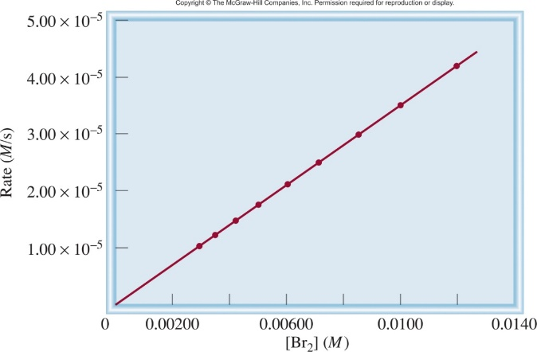
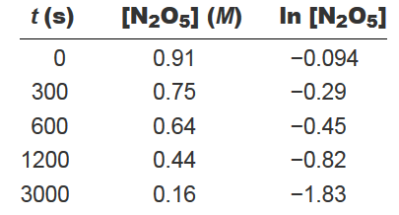
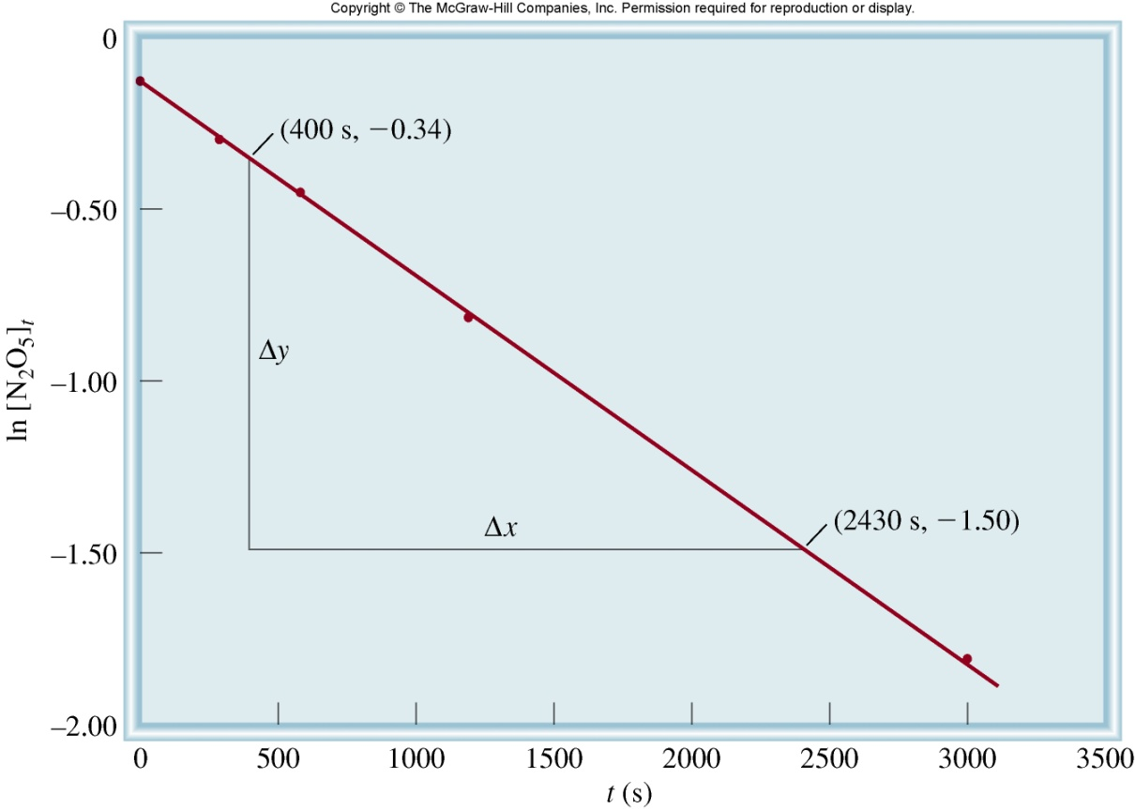


Determination of k
Earlier we found k by graphing Rate vs [conc]
rate = k [Br₂]
But you have to calc rate at each [conc] and then find the slope.
2N₂O₅ 4NO₂ (g) + O₂ (g)
y = m • x + b
ln[A]_{t} = -k • t + ln[A]₀
Measure concentration with time.
Graph date.
Math.

Slide 44
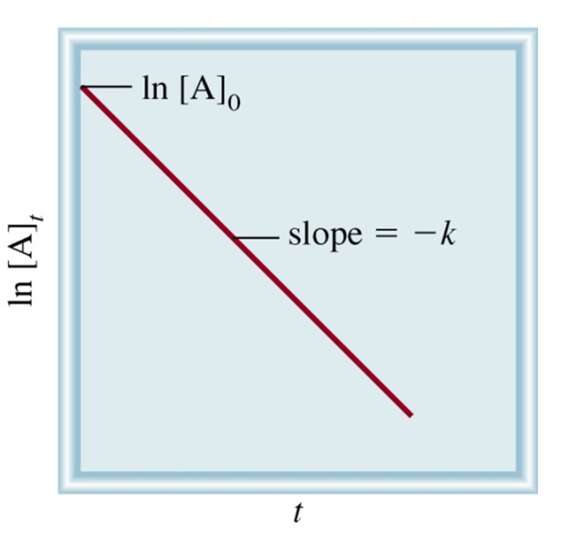
First Order Half-life
y = m • x + b
ln[A]_{t} = -k • t + ln[A]₀
ln[A]_{t}
= -k • t
ln[A]₀
Half-life (t_{½})-the time required for the concentration of a reactant to decrease to half of its initial concentration.
t_{½} = t when [A]_{t} = [A]₀/2
[A]₀
ln
[A]₀/2
ln 2
t_{½}
=
0.693
t_{½}
=
=
=
0.693
k
k
k
k

Slide 45
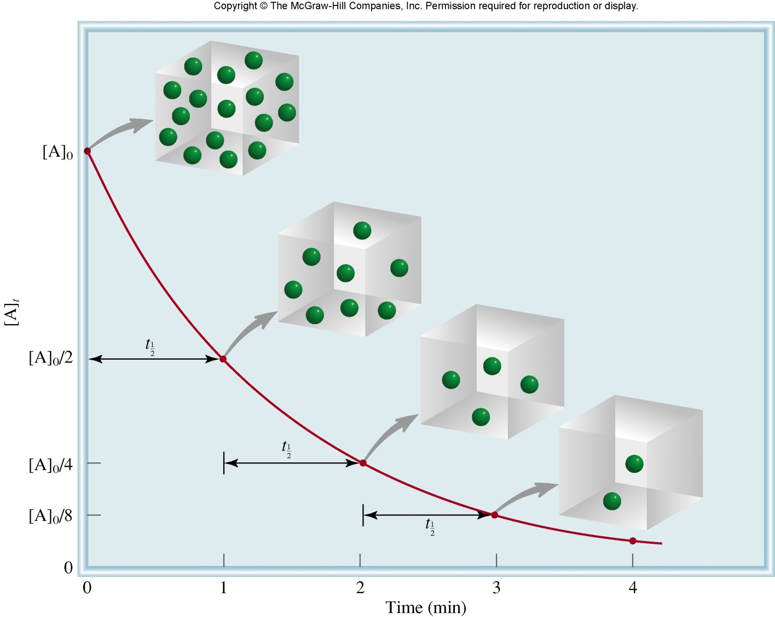
First Order Half-life
t_{½}
=
0.693
k
# of
half-lives
[A] = [A]₀/n
1
2
2
4
3
8
4
16
First order half-life is concentration independent!

Slide 46
Radioactive decay as 1st order rxns
Many radioactive decay processes are first order…
half-life of 8.04 days
half-life of 5730 yrs
half-life of 4.51 x 10⁹ yrs
Radiometric Dating-
An error margin of 2–5% has been achieved on dating younger Mesozoic rocks (252-266 million years old). Typically with uranium doped ZrSiO₄.
²³⁸U to ²⁰⁶Pb
¹⁴C radiometric dating.
Ratio of ¹⁴C to ¹²C

Slide 47

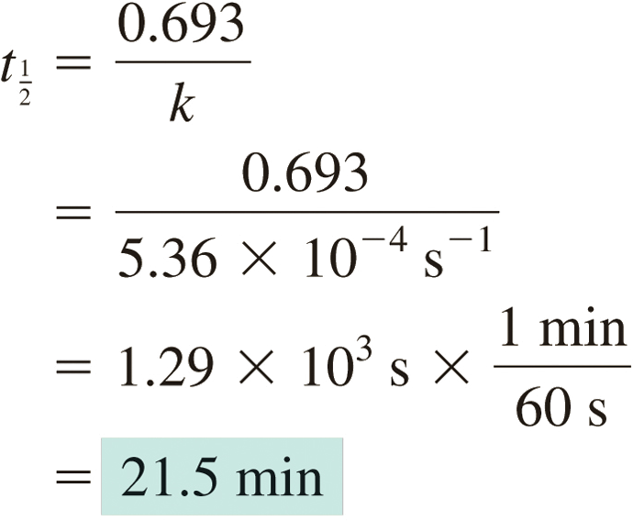
The decomposition of ethane (C₂H₆) to methyl radicals is a first-order reaction with a rate constant of 5.36 × 10⁻⁴ s⁻¹ at 700°C:
Calculate the half-life of the reaction in minutes.

Slide 48
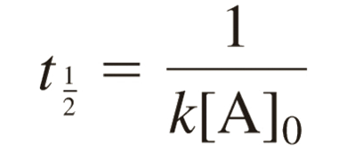
Second Order Reactions
Rate law can also be used, with minor modification, to predict concentrations at any time and vice versa!
A + A B
Reaction rate:
Rate Law:
Δ[A]
rate = -
rate = k [A]²
Δt
Δ[A]
-
= k [A]²
Δt
Second Order
Half-life
Calculus Happens!
1
=
kt +
1
[A]
[A]₀

Slide 49
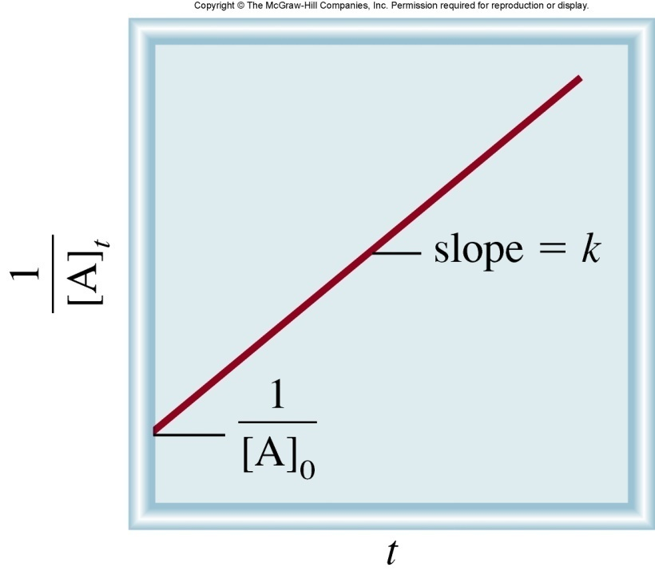
Second Order Reactions
1
=
kt +
1
[A]
[A]₀
t is time
[A]_{t} is the concentration of A at any time t
[A]₀ is the concentration of A at time t=0
k is the rate constant
y = m • x + b
1
=
kt +
1
[A]
[A]₀
Know [A]₀ and t, predict [A]_{t}
Know [A]₀ and [A]_{t}, predict t
Know [A]_{t} and t, predict [A]₀

Slide 50

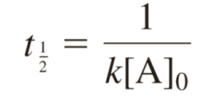
Iodine atoms combine to form molecular iodine in the gas phase
This reaction follows second-order kinetics and has the high rate constant 7.0 × 10⁹/M · s at 23°C.
If the initial concentration of I was 0.086 M, calculate the concentration after 2.0 min.
Calculate the half-life of the reaction if the initial concentration of I is 0.60 M, 0.42 M.
1
=
kt +
1
Know k. Given [A]₀ and t. Find [A]_{t}.
[A]
[A]₀
Know k. Given [A]₀. Find t.

Slide 51


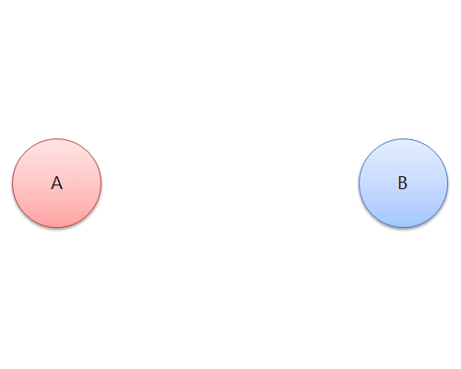
First and Second Order Reactions
rate = k [A]
rate = k [A]²
First Order Reaction
Second Order Reaction
ln[A]_{t} = -k • t + ln[A]₀
1
1
=
kt +
[A]
[A]₀
t_{½}
=
0.693
k

Slide 52
Zero Order Reactions
Independent of the concentration of starting material!
A B
Reaction rate:
Rate Law:
Δ[A]
rate = -
rate = k [A]⁰
Δt
rate = k
Δ[A]
-
= k
Δt
Calculus Happens!
[A]_{t} = -k • t + [A]₀

Slide 53
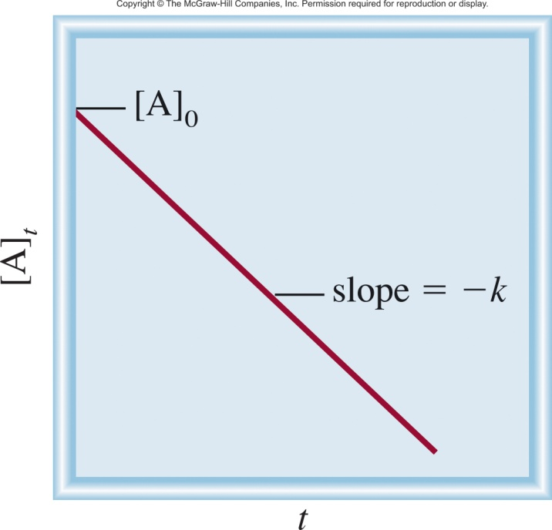
Zero Order Reactions
Independent of the concentration of starting material!
[A]_{t} = -k • t + [A]₀
t is time
[A]_{t} is the concentration of A at any time t
[A]₀ is the concentration of A at time t=0
k is the rate constant
y = m • x + b
[A]_{t} = -k • t + [A]₀
Know [A]₀ and t, predict [A]_{t}
Know [A]₀ and [A]_{t}, predict t
Know [A]_{t} and t, predict [A]₀

Slide 54
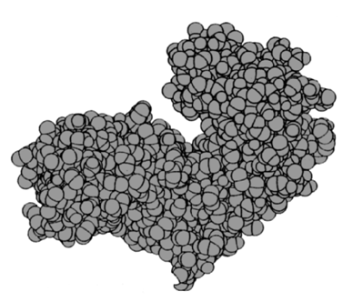


Zero Order Reaction Example
The amount of drug eliminated for each time interval is constant ,regardless of the amount in the body.
Rate | Amount of drug eliminated (mg) | Amount of drug in the body (mg) | Time (min)
 | - | 1000 | 0
100 mg/min | 100 | 900 | 1
100 mg/min | 100 | 800 | 2
100 mg/min | 100 | 700 | 3
100 mg/min | 100 | 600 | 4
100 mg/min | 100 | 500 | 5
100 mg/min | 100 | 400 | 6
rate = k [A]⁰
rate = k
Enzyme as a catalyst.
The slow step.

Slide 55

Zero Order Reaction Example
rate = k [NH₃]⁰ = k (1) = k = constant

Slide 56
Summary
Concentration-Time
Equation
Order
Rate Law
Units on k
Half-Life
[A]₀
0
rate = k
M s⁻¹
[A] = [A]₀ - kt
t_{½} =
2k
ln 2
1
rate = k [A]
s⁻¹
ln[A] = ln[A]₀ - kt
t_{½}
=
k
1
1
1
2
rate = k [A]²
M⁻¹ s⁻¹
=
+ kt
t_{½} =
[A]
[A]₀
k[A]₀

Slide 57
Summary
rate = k
rate = k [A]
rate = k [A]²
Zero Order Reaction
First Order Reaction
Second Order Reaction
[A]_{t} = -k • t + [A]₀
ln[A]_{t} = -k • t + ln[A]₀
1
1
=
kt +
[A]
[A]₀

Slide 58




Side note: Third Order Kinetics
Rare and typically slow!
One possibility for the mechanism of this reaction would be a three-body collision (i.e. a true termolecular reaction).

Slide 59



Experimental Kinetics
Set up the reaction.
Measure concentration change over time.
Graph the result.
Find the graph that generates a straight line.
Zero Order Reaction
First Order Reaction
Second Order Reaction
[A]_{t} = -k • t + [A]₀
ln[A]_{t} = -k • t + ln[A]₀
1
1
=
kt +
[A]
[A]₀

Slide 60

Zero Order Reaction
First Order Reaction
Second Order Reaction
[A]_{t} = -k • t + [A]₀
ln[A]_{t} = -k • t + ln[A]₀
1
1
=
kt +
[A]
[A]₀
Question:
zero order
first order
second order

Slide 61

Zero Order Reaction
First Order Reaction
Second Order Reaction
[A]_{t} = -k • t + [A]₀
ln[A]_{t} = -k • t + ln[A]₀
1
1
=
kt +
[A]
[A]₀
Question:
zero order
first order
second order

Slide 62

Zero Order Reaction
First Order Reaction
Second Order Reaction
[A]_{t} = -k • t + [A]₀
ln[A]_{t} = -k • t + ln[A]₀
1
1
=
kt +
[A]
[A]₀
Question:
zero order
first order
second order

Slide 63


Note: Units of k tells you the RO
$$rate\text{ = }k[A]^{m}[B]^{n}$$
$$M/\text{s}\text{ = }k{ M}^{m}{ M}^{n}$$
Order
Rate Law
Units on k
0
rate = k
M s⁻¹
1
rate = k [A]
s⁻¹
2
rate = k [A]²
rate = k [A][B]
M⁻¹ s⁻¹
3
rate = k [A]³
rate = k [A]²[B]
rate = k [A][B][C]
M⁻² s⁻¹

